Slide 1






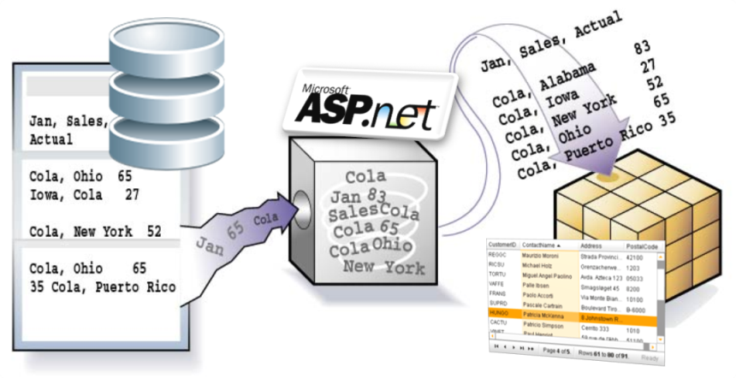

ASP.NET Data Source Controls
Building Data-Driven ASP.NET Web Forms Apps
Svetlin Nakov
Technical Trainer
http://nakov.com
Telerik Software Academy
academy.telerik.com

Slide 2

Table of Contents
ASP.NET Data Source Controls
SqlDataSource
EntityDataSource
ObjectDataSource
Accessing ADO.NET Entity Framework with EntityDataSource
Working with Editable Controls
Master-Details Navigation
Model Binding in Web Forms

Slide 3
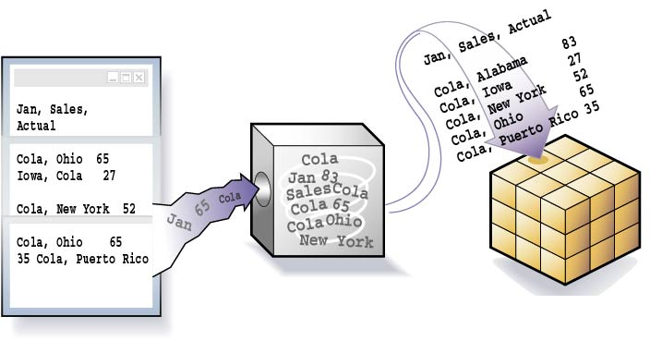

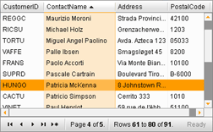
ASP.NET Data Source Controls

Slide 4
ASP.NET Data Source Controls
ASP.NET provides server controls that take care of data binding details
Known as data source controls
SqlDataSource, EntityDataSource, ObjectDataSource, XmlDataSource, …
They are an abstraction over the data source
Data-bound server controls can be associated to a data source control
Through the DataSourceID property

Slide 5


ASP.NET Data Source Controls
ASP.NET data source controls connect the data-bound controls with the database / ORM:
Typical scenario:
Data-Bound Control
Data-Source Control
ORM
Database
Web Form
EntityDataSource
Entity Frame-work
GridView control
SQL Server
Web Form

Slide 6
SqlDataSource
SqlDataSource provides connection to a relational DB (SQL Server, Oracle, OLE DB, …)
Data is manipulated by using commands
Select, Update, Insert and Delete commands
Commands can be either SQL queries or names of stored procedures
Data is processed with a DataSet (by default)
The DataSourceMode property specifies whether to use DataSet or DataReader
Old-fasioned, better use EntityDataSource

Slide 7
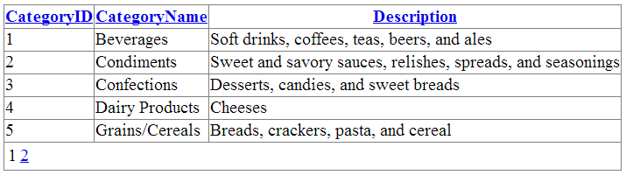
SqlDataSource – Example
<asp:SqlDataSource ID="DSCategories" runat="server"
ConnectionString="<%$ ConnectionStrings:Northwind %>"
SelectCommand="SELECT * FROM [Categories]" />
<asp:GridView ID="GridViewCategories" runat="server"
DataSourceID="DSCategories" DataKeyNames="CategoryID"
AutoGenerateColumns="True" AllowPaging="True"
AllowSorting="True">
</asp:GridView>

Slide 8
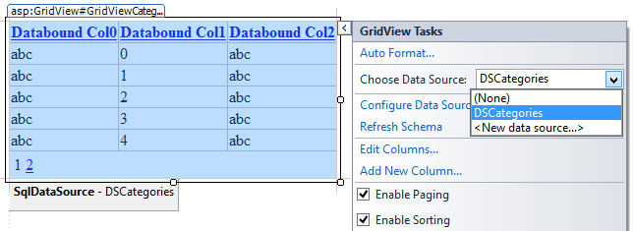
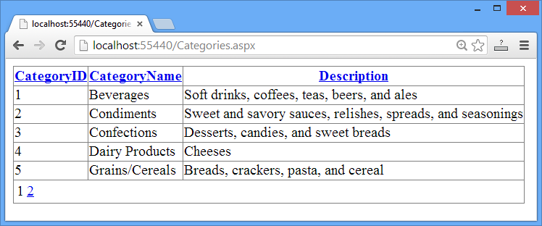
SqlDataSource and GridView
Live Demo

Slide 9
EntityDataSource
The EntityDataSource
Provides data binding in Web applications that use the ADO.NET Entity Framework (EF)
Implements CRUD (create, read, update, and delete) operations
Against a database mapped through EF
On behalf of data-bound controls
Supports complex queries, sorting and paging
The Entity Data Model Designer in VS is used to create the EF mappings (.edmx)

Slide 10
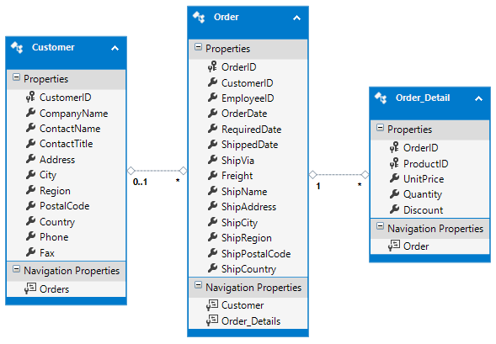
EntityDataSource – Example
Define the Entity Data Model (.edmx)
Put a list control in the form (e.g. ListBox)
<asp:ListBox ID="ListBoxCustomers" runat="server">
</asp:ListBox>

Slide 11
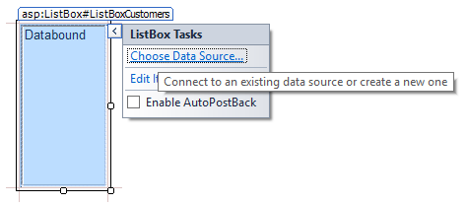
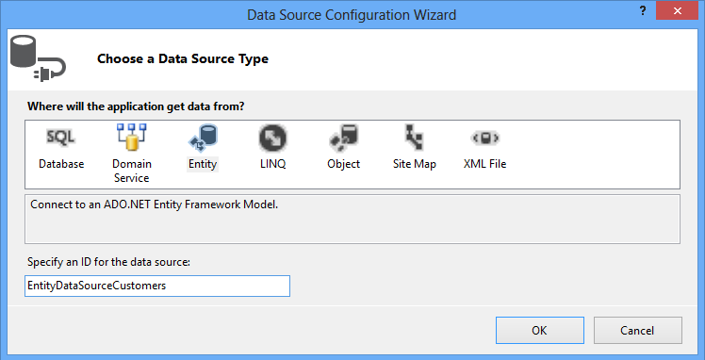
EntityDataSource – Example (2)
Bind the ListBox to the data model
Select the new "Entity" option in the dialog box

Slide 12
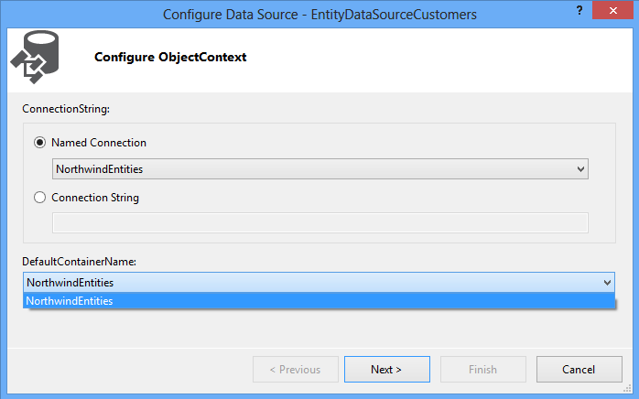
EntityDataSource – Example (3)
The VS Designer will then display the available Entity Containers

Slide 13
EntityDataSource – Example (4)
ListBox control bound an EntityDataSource:
<asp:EntityDataSource
ID="EntityDataSourceCustomers" runat="server"
ConnectionString="name=NorthwindEntities"
DefaultContainerName="NorthwindEntities"
EntitySetName="Customers" />
<asp:ListBox ID="ListBoxCustomers" runat="server"
DataSourceID="EntityDataSourceCustomers"
DataTextField="CompanyName" Rows="10"
DataValueField="CustomerID" />

Slide 14

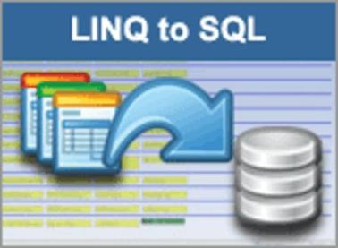

ListBox Bound to EF through EntityDataSource
Entity Framework
Live Demo

Slide 15
Master-Detail Navigation
Master-details navigation could be implemented through filtering:
<asp:EntityDataSource ID="DSCustomers" runat="server"
EntitySetName="Customers" … />
<asp:ListBox ID="ListBoxCustomers" runat="server"
DataSourceID="EntityDataSourceCustomers" … />
<asp:EntityDataSource ID="DSOrders" runat="server"
EntitySetName="Orders" Where="it.CustomerID=@CustID">
<WhereParameters>
<asp:ControlParameter Name="CustID" Type="String"
ControlID="ListBoxCustomers" />
</WhereParameters>
</asp:EntityDataSource>

Slide 16
EntityDataSource: Hints
To access navigational properties in EntityDataSource use "Include"
To use strongly-typed binding (ItemType) use EnableFlattening="false"
<asp:EntityDataSource ID="DataSourceOrderDetails"
ConnectionString="name=NorthwindEntities"
DefaultContainerName="NorthwindEntities"
EntitySetName="Order_Details" Include="Product"
runat="server" … />
<asp:EntityDataSource ID="DataSourceOrderDetails"
runat="server" EnableFlattening="false" … />

Slide 17
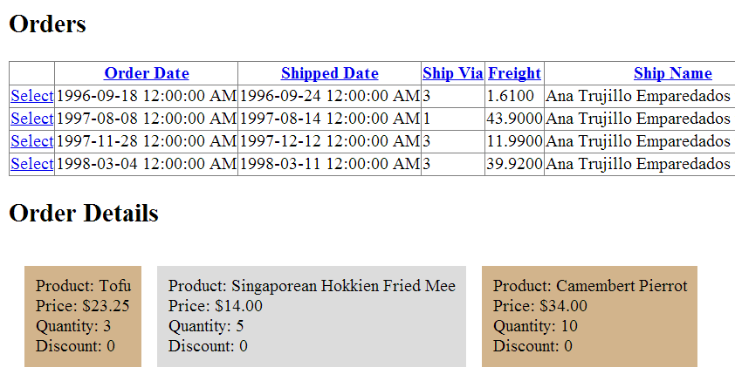
Master-Details Navigation (EntityDataSource + Filters)
Live Demo

Slide 18
Editable EntityDataSource
<asp:EntityDataSource ID="EntityDataSourceCustomers"
runat="server" ConnectionString="name=…"
DefaultContainerName="NorthwindEntities"
EnableInsert="True" EnableUpdate="True"
EnableDelete="True" EntitySetName="Customers">
</asp:EntityDataSource>
<asp:ListView ID="ListViewCustomers" runat="server"
DataKeyNames="CustomerID"
DataSourceID="EntityDataSourceCustomers">
<LayoutTemplate>…</LayoutTemplate>
<ItemTemplate>…</ItemTemplate>
<EditTemplate>…</EditItemTemplate>
<InsertTemplate>…</InsertItemTemplate>
</asp:ListView>

Slide 19
BindItem and Bind(…)
Editable controls require a two-way binding (data field ←→ UI control)
Use BindItem.Field for strongly-typed binding instead of Item.Field
Use Bind("PropertyPath") for standard binding instead of Eval("PropertyPath")
<EditItemTemplate>
Company Name: <asp:TextBox ID="TextBoxCompanyName"
runat="server" Text='<%# BindItem.CompanyName %>' />
…
</EditItemTemplate>

Slide 20


Editable ListView with EF and EntityDataSource
Entity Framework
Live Demo

Slide 21
ObjectDataSource
ObjectDataSource enables data-binding of UI control to collection of objects
Instead of directly binding to a database
Needs a middle-tier business object class
A class providing the Select, Update, Insert, Delete methods (CRUD operations)
ObjectDataSource properties
TypeName – name of the business object class
SelectMethod, UpdateMethod, …

Slide 22
ObjectDataSource – Example
<asp:ObjectDataSource ID="dsProducts"
runat="server" TypeName="ObjectDataSourceProducts"
SelectMethod="GetAll" InsertMethod="Insert"
UpdateMethod="Update" DeleteMethod="Delete">
</asp:ObjectDataSource>
<asp:GridView ID="GridViewProducts" runat="server"
DataSourceID="dsProducts" DataKeyNames="ProductID">
</asp:GridView>
public class ObjectDataSourceProducts
{
public IEnumerable<Product> GetAll() { … }
public int UpdateProduct(Product p) { … }
…
}

Slide 23
Building File System Explorer with ObjectDataSource
Define a class to get all files from given folder
Add GetAllFiles() method to return a collection of FileInfo objects
public class FileSystemManager
{
public static IEnumerable<FileInfo>
GetAllFiles(string folder)
{
var files = Directory.GetFiles(folder);
return files;
}
}

Slide 24
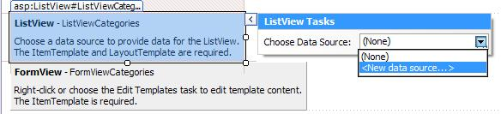
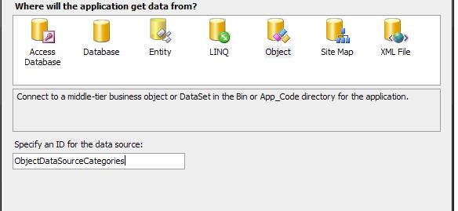
Building File System Explorer with ObjectDataSource (2)
Add a ListView control in the form
Bind the ListView to the ObjectDataSource

Slide 25
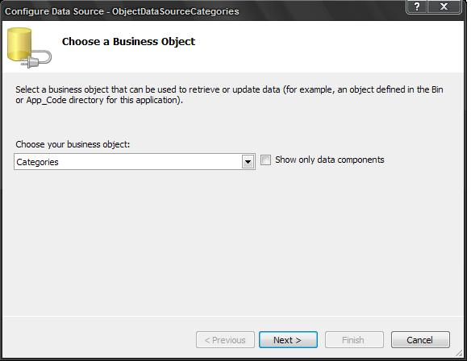
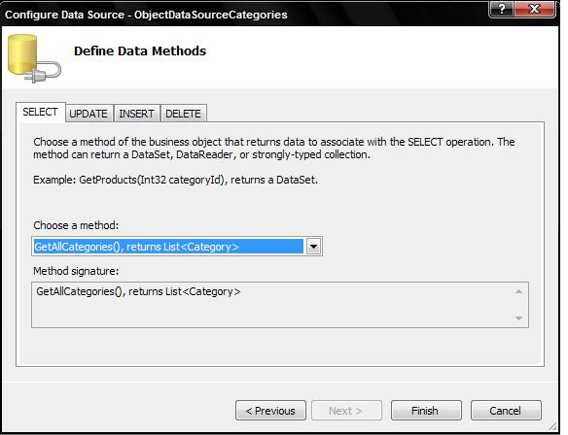
Building File System Explorer with ObjectDataSource (3)
Next choose your custom class FilesManager
And choose the GetAllFiles(…) method as "SELECT Method"

Slide 26
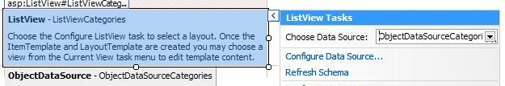
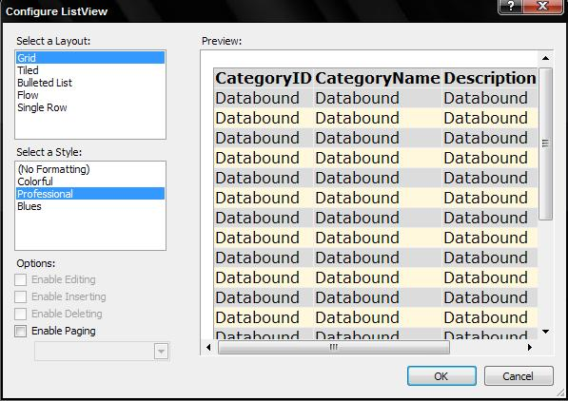
Building File System Explorer with ObjectDataSource (4)
Click to configure the ListView control
Optionally choose layout and style

Slide 27
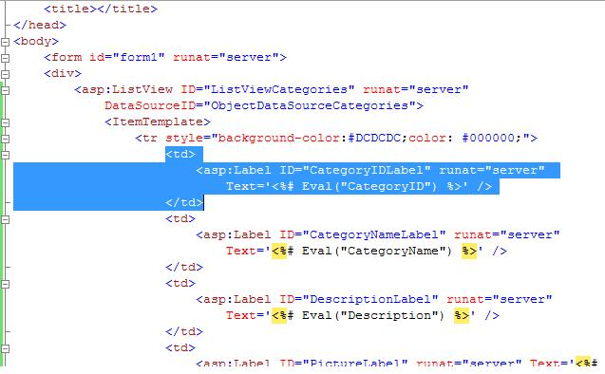
Building File System Explorer with ObjectDataSource (5)
Customize the ListView to show only rows you like
Add a parameter for the SELECT method
<SelectParameters>
<asp:Parameter DefaultValue="C:\WINDOWS"
Name="rootFolder" Type="String" />
</SelectParameters>

Slide 28
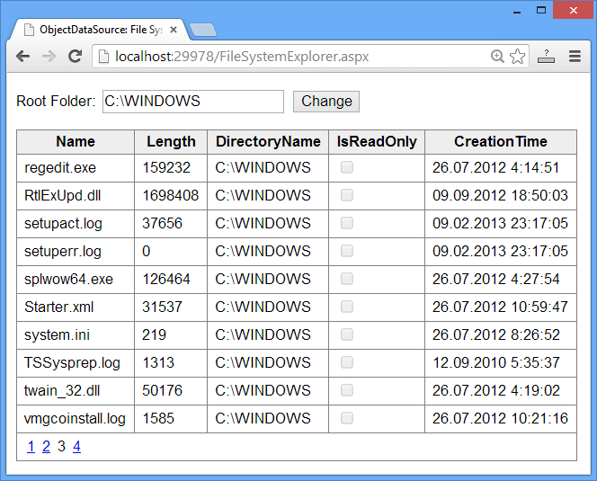
Building File System Explorer with ObjectDataSource (6)
The result is:

Slide 29



Using ObjectDataSource
Live Demo

Slide 30
Other Data Sources
LinqDataSource
For LINQ-to-SQL ORM mappings (legacy)
Hierarchical
XmlDataSource
Establishes a connection to an XML source of data (files, documents)
DataFile, TranformFile, XPath
SiteMapDataSource
MS Access – AccessDataSource
Derives from SqlDataSource

Slide 31

Model Binding
CRUD Operations Made Easy

Slide 32
What is Model Binding?
What is "model"?
In data-driven applications "models" are classes that hold the data behind the UI controls
What is "model binding" in ASP.NET?
Bind data controls directly to methods that provide CRUD functionality
SelectMethod → returns IQueryable<T>
InsertMethod, UpdateMethod, DeleteMethod → edit the model (entity)

Slide 33
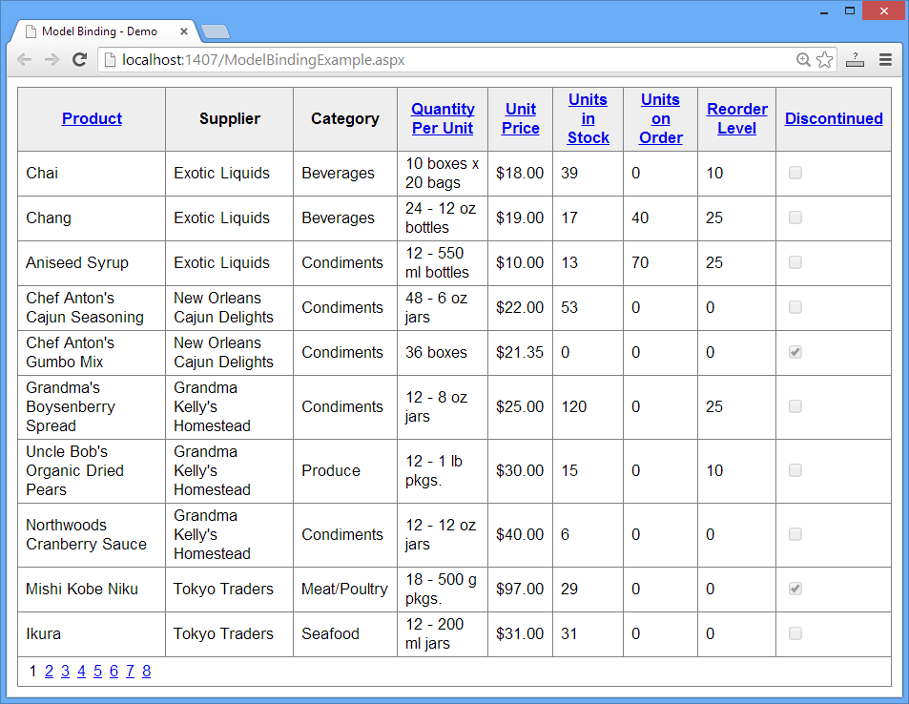
Model Binding
Live Demo

Slide 34
ASP.NET Data Source Controls
http://academy.telerik.com

Slide 35
Exercises
Create a database holding continents, countries and town. Countries have name, language, population and continent. Towns have name, population and country. Implement an ASP.NET Web application that shows the continents in a ListBox, countries in a GridView and the towns in a ListView and allows master-detail navigation. Use Entity Framework and EntityDataSource. Provide paging and sorting for the long lists. Use HTML escaping when needed.
Implement add / edit / delete for the continents, countries, towns and languages. Handle the possible errors accordingly. Ensure HTML special characters handled correctly (correctly escape the HTML).

Slide 36
Exercises (2)
Add a flag for each country which should be a PNG image, stored in the database, displayed along with the country data. Implement "change flag" functionality by uploading a PNG image.
Write a "TODO List" application in ASP.NET. It should be able to list / create / edit / delete TODOs. Each TODO has title, body (rich text) and date of last change. The TODOs are in categories. Categories should also be editable (implement CRUD).
* Write ASP.NET Web Forms application to display in a GridView all tweets from given Twitter user. Load the tweet though the Twitter API. Bind the tweets to the GridView thorugh ObjectDataSource.

Slide 37



Free Trainings @ Telerik Academy
"Web Design with HTML 5, CSS 3 and JavaScript" course @ Telerik Academy
html5course.telerik.com
Telerik Software Academy
academy.telerik.com
Telerik Academy @ Facebook
facebook.com/TelerikAcademy
Telerik Software Academy Forums
forums.academy.telerik.com

